Slide 1

Heredity and Evolution
Evolution And Its Progress

Slide 2
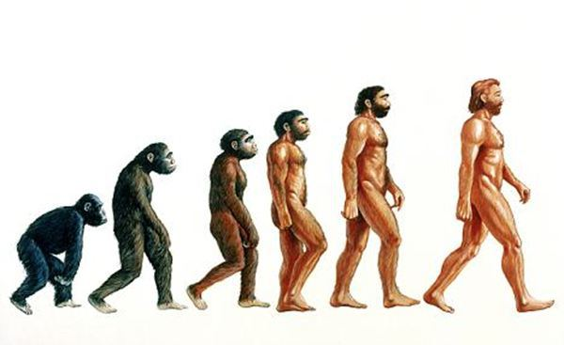
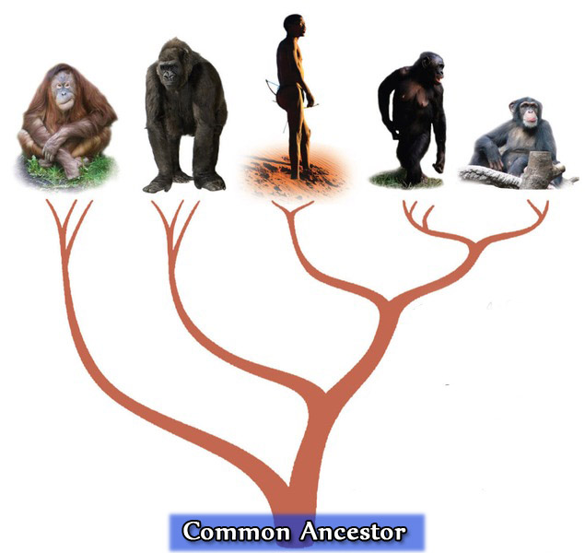
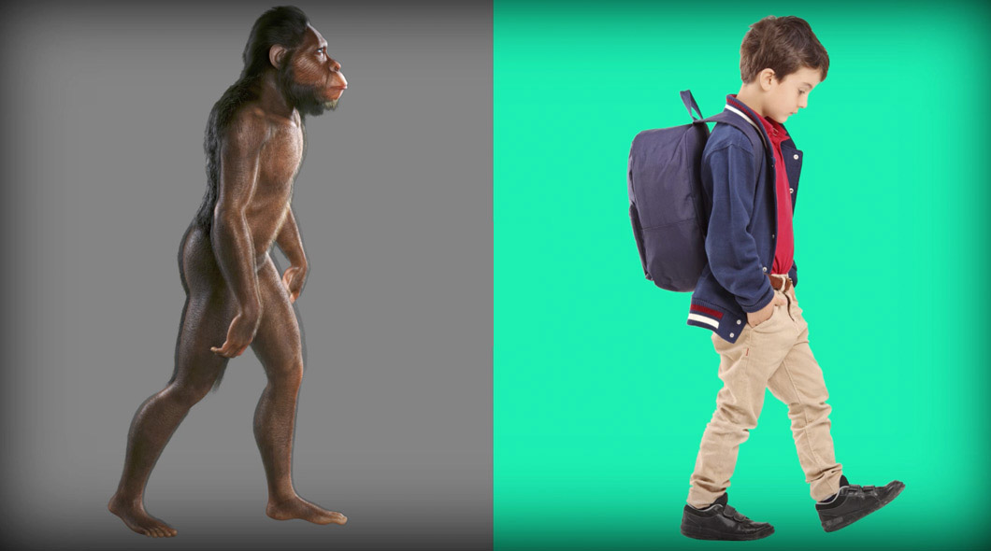
Evolution and its progress
It is not true that human beings have
evolved from chimpanzees.
Rather, both human beings and chimpanzees have a common ancestor a long time ago.
Common ancestor is likely
to have been neither human or chimpanzee.
The two resultant species have probably evolved in their own separate ways to give rise to the current forms.
Hence we can see there is no real progress in the idea of evolution.

Slide 3
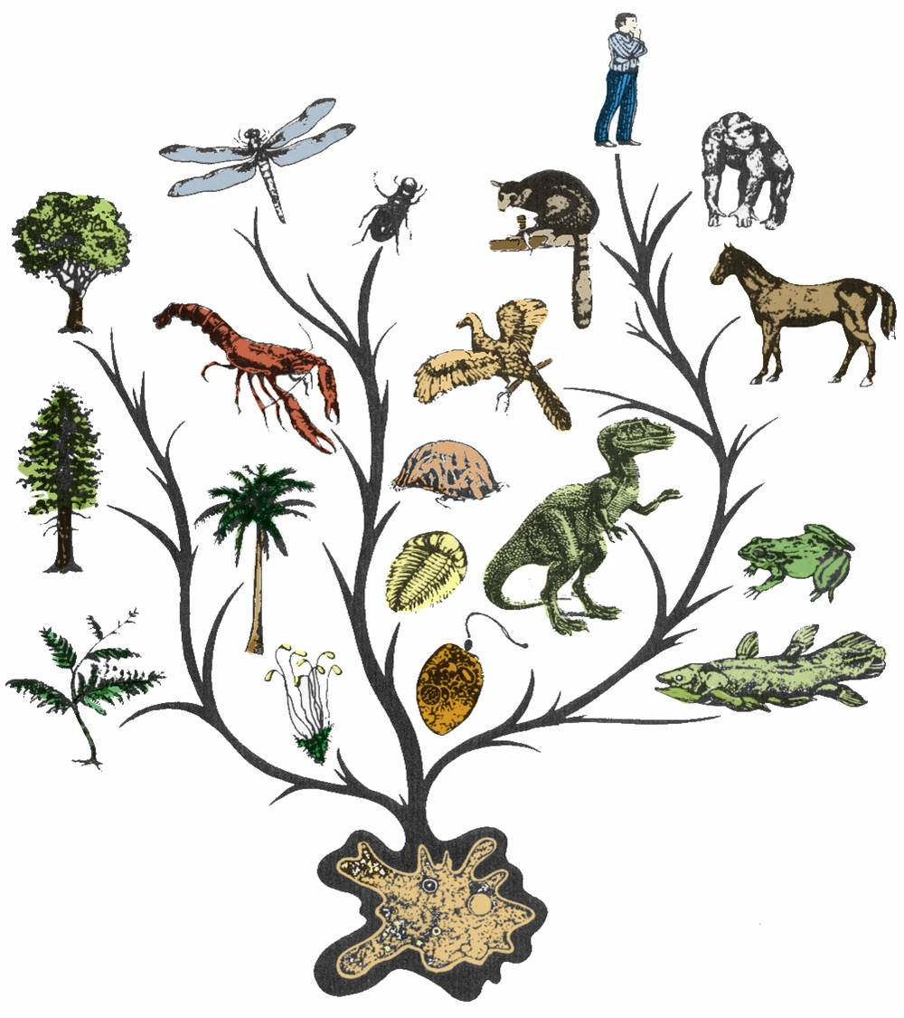
Evolution and its progress
Evolution is simply the generation of diversity and the shaping of the diversity by environmental selection.

Slide 4
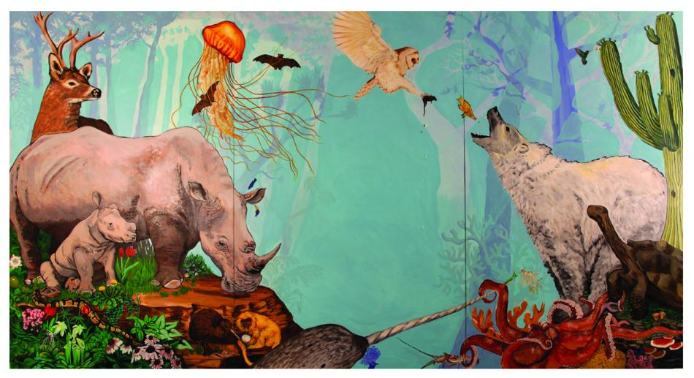
Evolution and its progress
The only progressive trend in evolution seems to be that more and more complex body designs have emerged over time.

Slide 5
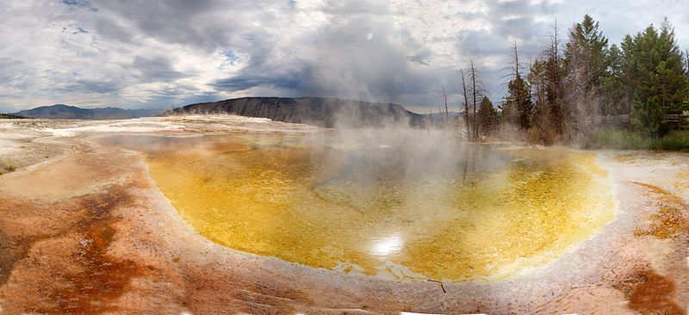


Evolution and its progress
It is not as if the older designs are inefficient!
Many of the older and simpler designs still survive.
In fact, one of the simplest life forms – bacteria – inhabit the most inhospitable habitats, like
Hot springs
Deep sea
Thermal vents
Ice in Antarctica

Slide 6

Evolution and its progress
In other words, human beings are not the pinnacle of evolution, but simply yet another species in the teeming spectrum of evolving life.

Slide 7
Thank You

